Slide 1
Incident Disease Capstone
How to Accurately Determine Incidence of Proliferative Diabetic Retinopathy in Electronic Health Records
Presenter: Ritika Batte
Committee: Catherine Sun, MD, Thomas Hoffman, PhD, Suzzane Dufault, PhD

Slide 2
Background

Slide 3
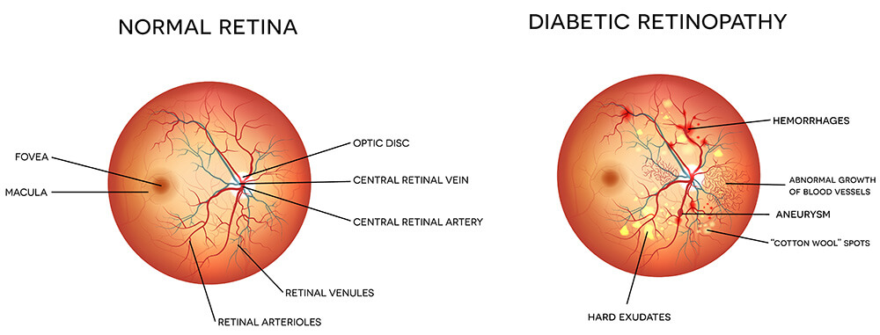
Proliferative Diabetic Retinopathy (PDR)
Advanced stage of diabetic retinopathy characterized by abnormal blood vessel growth in the retina, leading to vision impairment or blindness
Importance → Timely identification is important for preventing complications and optimizing treatments
Conversion from Non-proliferative diabetic retinopathy (NPDR) to PDR is often used as an endpoint in studies

Slide 4
Electronic Health Record (EHR)
Digital version of a patient’s medical history, maintained by a healthcare provider over time
Consists of structured (Diagnosis/procedure codes) and unstructured data (free-text clinical notes)
Challenges: Accurate identification of incident PDR cases in EHR
EHR records only go back a finite period (UCSF transitioned to Epic in 6/2012)
Patients may receive care at multiple health systems, resulting in incomplete EHR data

Slide 5
Determine the most accurate classification method to identify incident PDR in the EHR

Slide 6
Methods

Slide 7
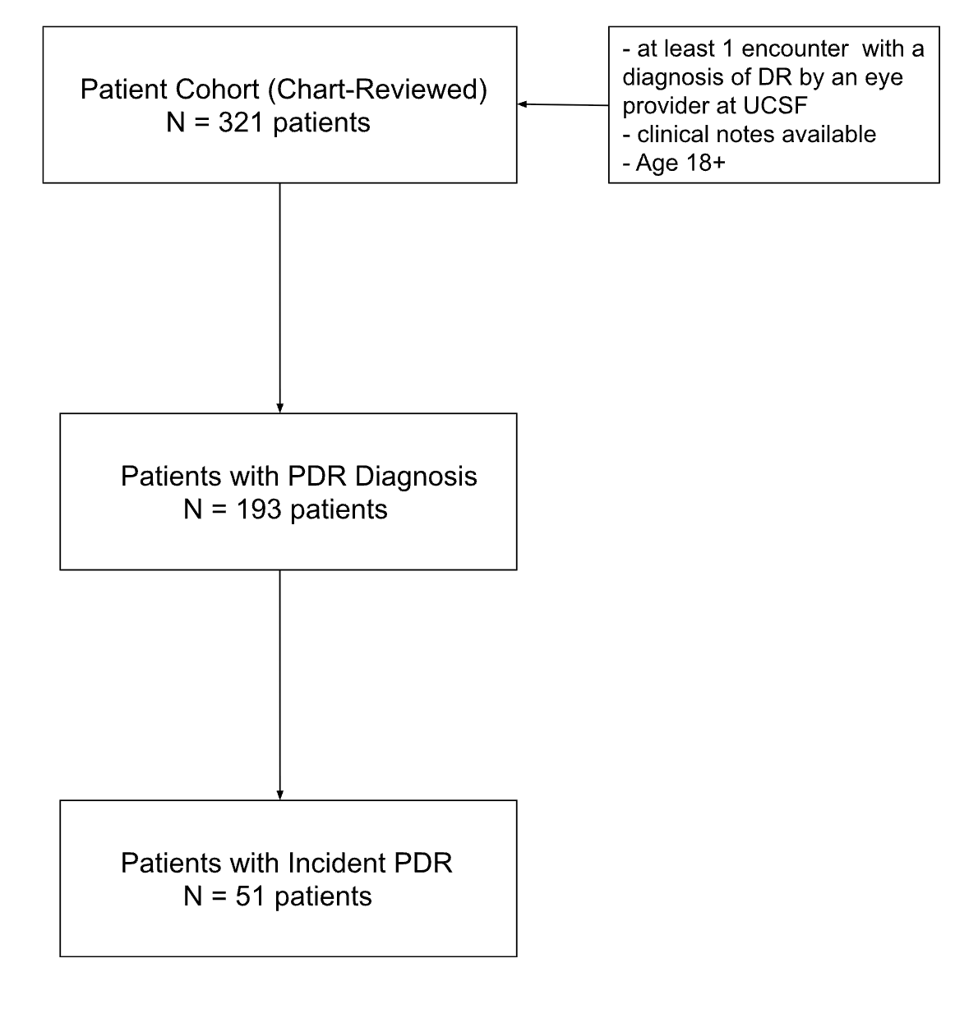
Patient Cohort
From UCSF De-identified Clinical Data Warehouse

Slide 8
Gold Standard (GS)
Manual chart review by ophthalmologists
Incident PDR = first documented evidence of PDR
Dates with insufficient information were excluded
Ie. missing month or year
± 90-day window for matching prediction to gold standard
Balanced and flexible for real-world variability in clinical documentation

Slide 9
Classification Methods (1-3)
All these 3 methods look at the Diagnosis Codes for PDR
ICD-9-CM: 362.02
ICD-10-CM : E08.35X, E09.35X, E10.35X, E11.35X, E13.35X
1. ICD-Only (No Lookback)
First PDR code, no history check
2. ICD + 1 Year Lookback period (All Departments)
PDR code and 1-year prior UCSF visit
3. ICD + 1 Year Lookback period (Ophthalmology Only)
PDR code and 1-year prior UCSF visit, but only in Ophthalmology and Francis I. Proctor Foundation
ICD = International Classification of Diseases

Slide 10
Classification Methods (4-6)
4. Rule-based NLP
Matches “PDR” and extracts the first date of diagnosis in the assessment/plan section of the notes using scispaCy + negation detection [3]
5. ICD + NLP
Combines the best-performing ICD method, based on how well the date is matched to the GS date, with the rule-based NLP
6. Generative AI (LLM)
GPT-4o via UCSF’s Versa platform to identify PDR and extract the first diagnosis date

Slide 11
Versa Prompt
You are a physician reviewing a set of clinical assessment and plan notes for a patient. Your task is to determine whether the patient has been diagnosed with proliferative diabetic retinopathy (PDR) based on the information provided in the notes. Please extract the following:
Does this patient have proliferative diabetic retinopathy (PDR)?
Answer Yes or No/Uncertain
If Yes, identify the first documented date of PDR diagnosis in the format YYYY-MM-DD.
Provide supporting context from the note, such as keywords, findings, or treatments that indicate the diagnosis.
If multiple notes are provided, focus on the first documented occurrence of PDR.
Here are the notes:

Slide 12
Evaluation Metrics
Metrics used:
Sensitivity
Specificity
Positive Predictive Value (PPV)
Negative Predictive Value (NPV)
F1-score
Bootstrap CI (1,000 samples) used for reliability
All statistical analysis was done using R

Slide 13
Results

Slide 14
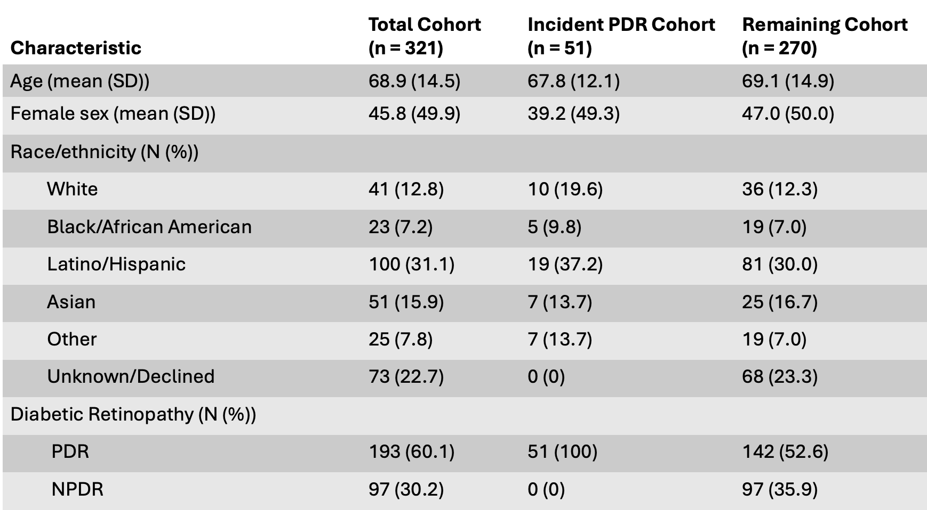
Table 1 – Demographics
Confirmed PDR cases: 193
Incident PDR cases: 51
Mean age (overall): 68.9 years
Mean age (incident PDR): 67.8 years
Largest racial/ethnic group: Latino/Hispanic

Slide 15
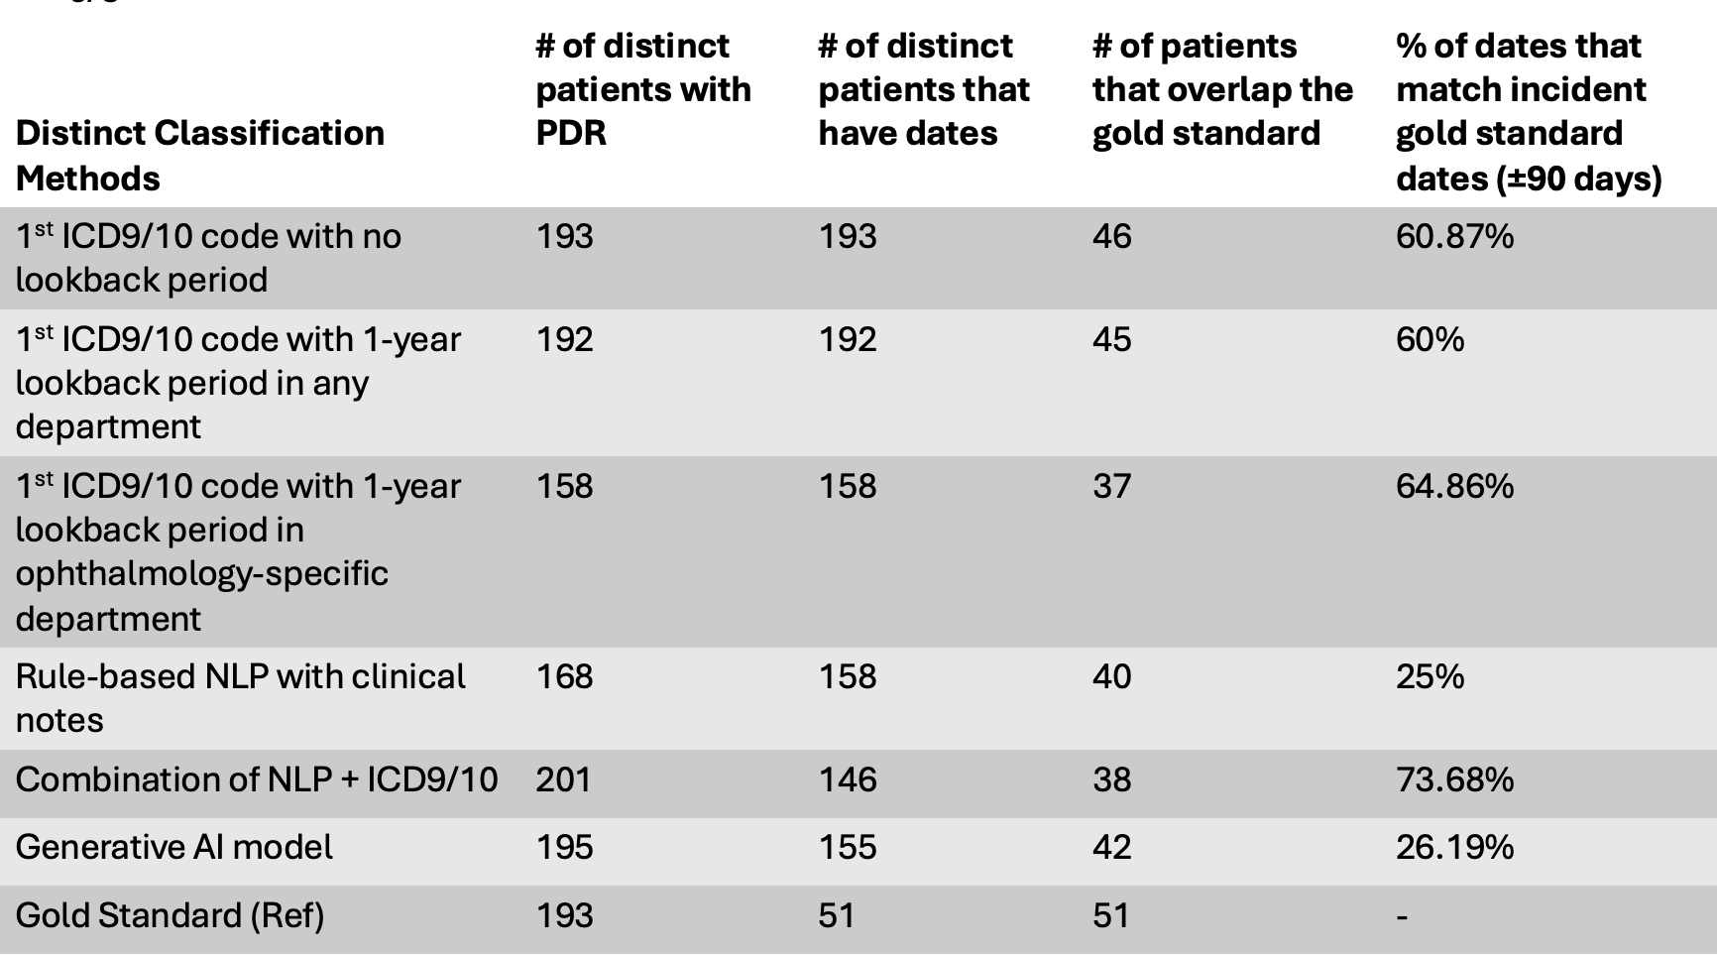
Table 2 – Comparison of First PDR Dates
Best temporal match: ICD + 1 Yr (Ophthalmology Only)
64.86% within ±90 days of gold standard
ICD + NLP hybrid method:
Highest accuracy 73.68% of overlapping cases aligned with gold standard
suggests combining structured + unstructured data improves incident date detection

Slide 16
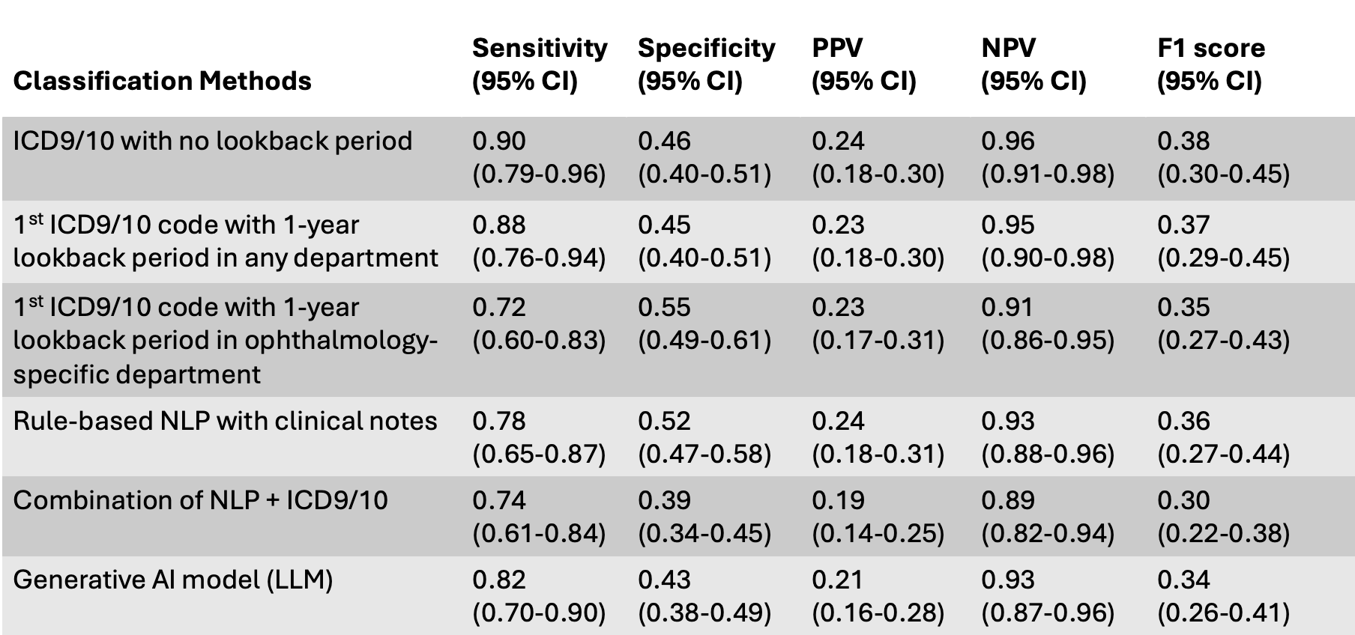
Table 3 – Performance Metrics for GS Dates
Combining the best ICD + NLP → improves coverage
NPV remains high across all methods: ≥ 0.89
F1 scores range: 0.23 to 0.34
ICD + 1 Year (Ophthalmology Only) → best balanced ICD method

Slide 17
Discussion

Slide 18
Conclusion & Next Steps
Key Findings
ICD-only methods had high sensitivity but also overidentified previously diagnosed cases
NLP and LLM methods better captured unstructured clinical detail, but struggled with timing accuracy
Trade-offs
Structured codes are reliable and scalable, but lack diagnostic context
GPT-4o offers contextual flexibility but is limited by vague documentation and can overgeneralize
Implications
Notes rarely state “first diagnosis” clearly
Outside care means prior diagnoses may not appear in the EHR
Future Direction
more advanced NLP and deep learning models trained specifically on ophthalmology notes

Slide 19
Thank You!

Slide 20
References

Slide 21
[1] Fu JT, Sholle E, Krichevsky S, Scandura J, Campion TR. Extracting and classifying diagnosis dates from clinical notes: A case study. J Biomed Inform. 2020 Oct;110:103569. [DOI]
[2] Schmier JK, Covert DW, Lau EC, Matthews GP. Medicare expenditures associated with diabetes and diabetic retinopathy. Retina 2009; 29:199–206 [DOI]
[3] Sean Yonamine, Chu Jian Ma, Rolake O. Alabi, Georgia Kaidonis, Lawrence Chan, Durga Borkar, Joshua D. Stein, Benjamin F. Arnold, Catherine Q. Sun, Comparison of Diagnosis Codes to Clinical Notes in Classifying Patients with Diabetic Retinopathy, Ophthalmology Science, Volume 4, Issue 6, 2024, 100564, ISSN 2666-9145, [DOI]
[4]Pan J, Lee S, Cheligeer C, Martin EA, Riazi K, Quan H, Li N. Integrating large language models with human expertise for disease detection in electronic health records. Comput Biol Med. 2025 Jun;191:110161. [DOI]
[5] Stein JD, Rahman M, Andrews C, et al. Evaluation of an Algorithm for Identifying Ocular Conditions in Electronic Health Record Data. JAMA Ophthalmology. 2019;137(5):491–497. [DOI]
[6] University of California, San Francisco. UCSF Versa, Assistants, and API. UCSF Center for Intelligent Imaging. Published 2023. Accessed June 8, 2025. [DOI]

